Slide 1
SPYMAC
A network process monitoring system
Guide
Prof. Zakir M Shaikh
By
Ajay Pratap Singh
Amir Javed
Animesh Saxena
Madhur Ahuja

Slide 2
Introduction
To create a application which will give
full control, to administrator on the
server over the clients activities,
so that it will be able to monitor its
activities in term of processes.

Slide 3
Goals
List active machines in the specified IP address range
List all processes on those machines
Capability to terminate illegal processes
Capability of taking snapshot of the client machine
Provide a geographical representation of machines

Slide 4
Platform : Microsoft Visual C++
Easy access to operation system primitives
Primitives like
  Process listing
  Process termination
Availability of Socket Application Programming Interface

Slide 5
Components
GUI – providing menu and facilities
Machine scanning- pings machine to find out whether it is active/inactive
Process listing –uses the ProcessInfo32 structure
Process termination- terminates the process
Geographical orientation- displays topography

Slide 6
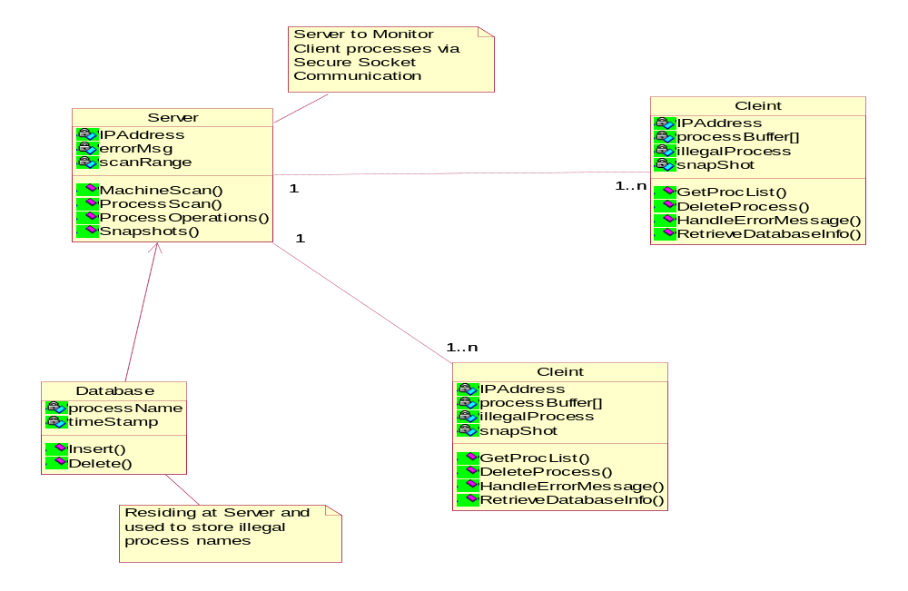
Class diagram

Slide 7
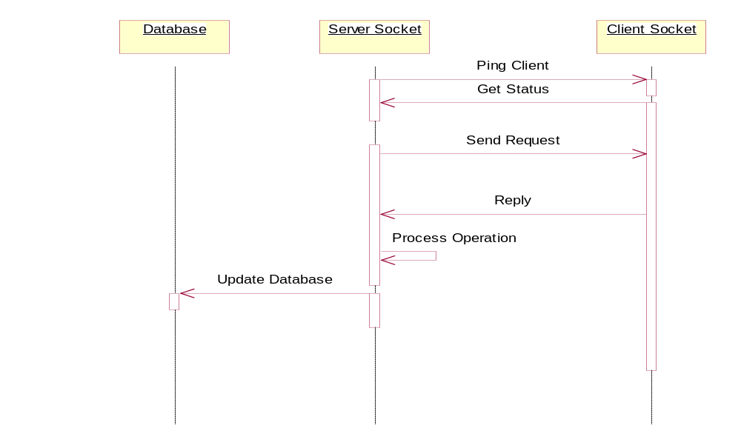
Sequence diagram

Slide 8
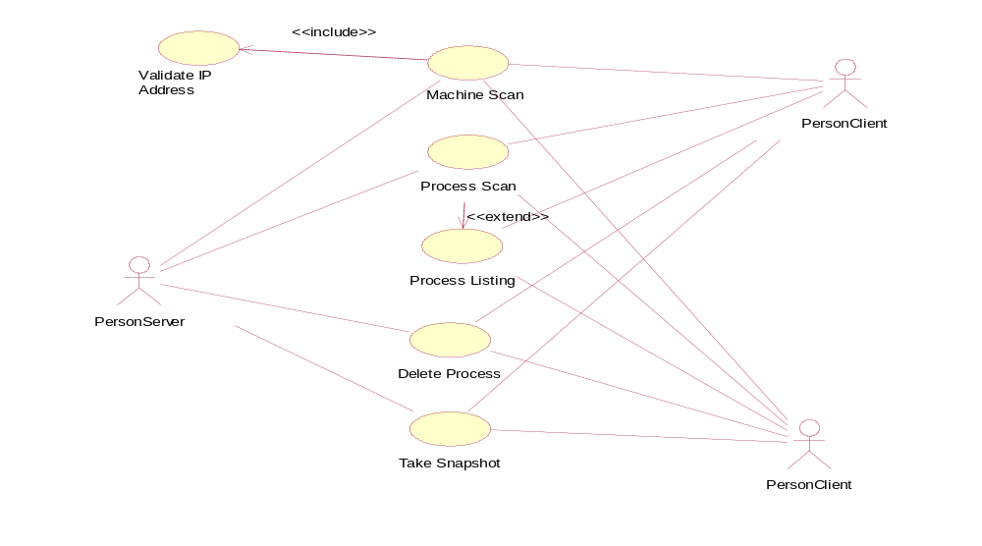
Use case diagram

Slide 9
COGNITIVE
WALKTHROUGH of the Project

Slide 10
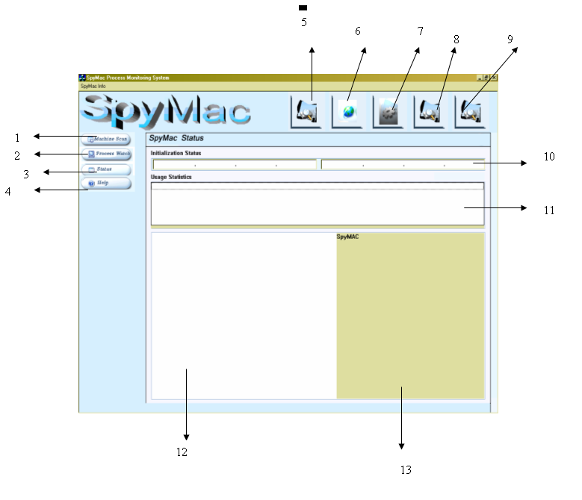

Slide 11
The main screen components
    Machine Scan Button: To ping machines given in the IP Address boxes (10)
    Process Watch Button: This scans the currently selected machine for process listing
    Status: Shows the log file created for entering information related to process errors
    Help: Displays the standard about dialog box
    Displays the snapshot of the active window on the client process
    Terminates the process currently selected
    Scans the database for entries of any illegal processes and terminates the same on the client machine selected for scanning
    Shows processes from many machines simultaneously
    Displays the topography of the lab, floor.
    It is used by the administrator to enter the IP Address range for scanning
    It is used for displaying common error messages
    It is used to display the tree structure
    It is used to display snapshots

Slide 12
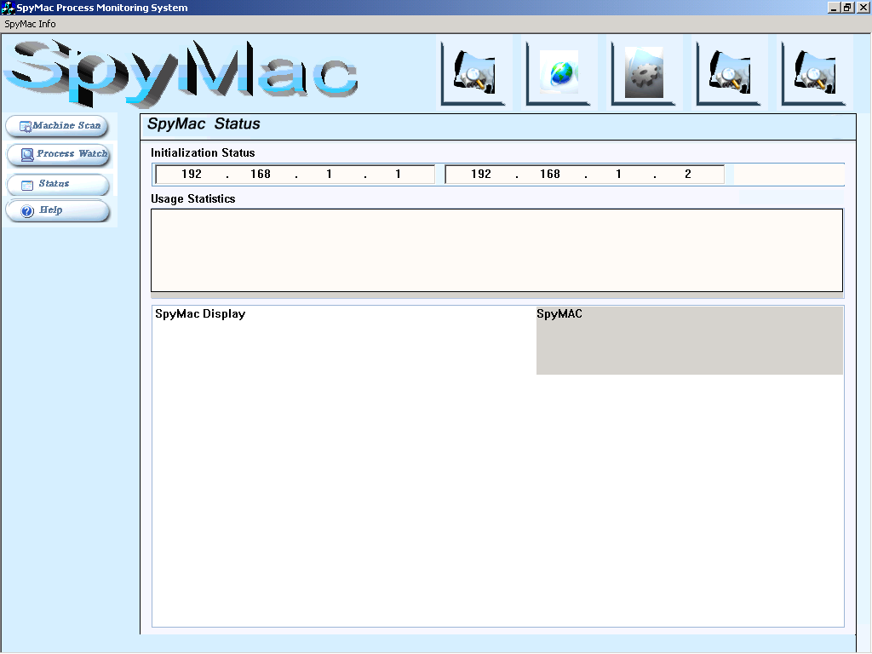

Slide 13
Here the user is required to enter the IP address in space provided
The IP address the user has to enter in the following format
xxx.yyy.vvv.zzz
Then the user is required to press the machine scan button

Slide 14
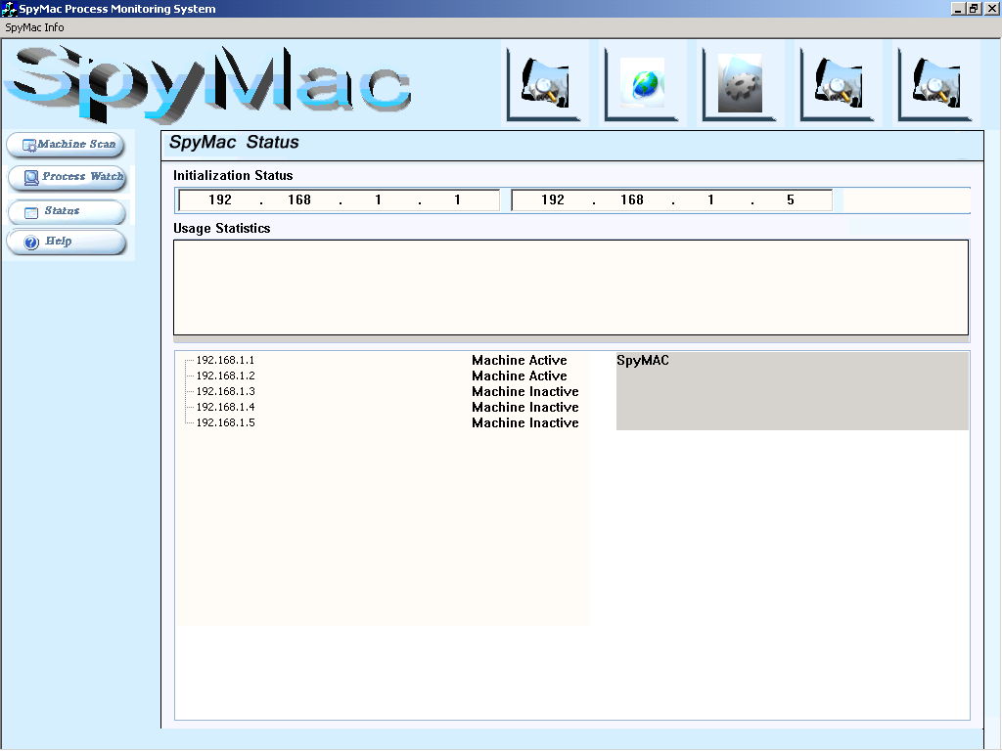

Slide 15
Once the user has pressed the machine scan button application pings all the machines in the given IP address range
Ping- it’s a process of sending request packets to the target machine to determine whether the machine is active or not
The reply is displayed as a tree structure
The tree contains information whether the machine is active or not

Slide 16
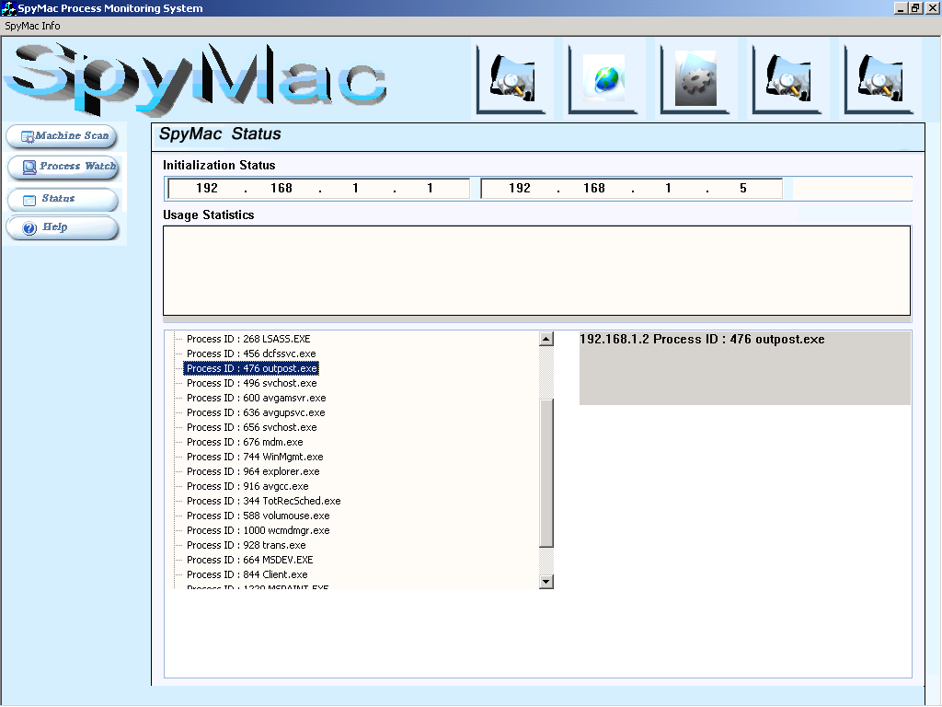

Slide 17
Then the user clicks on the machine IP address to select the machine
After that the process watch button is clicked to get the list of active process running on that machine
Now the user is provided with several choices
  Terminate the process
  Take a snapshot of the client
  Get the list of illegal process from database and terminate them & activate the timer
  Store the list of active processes in the file

Slide 18
Terminate the process
  By clicking this button will send the command to the client system to terminate the process immediately
  This command is sent using socket communication
Snapshot
  This command takes the snapshot of the client system and stores it in a bitmap file which is displayed by the server

Slide 19
Database Action
  When user clicks this button the program compares the process list in the database from the active process list and sends the appropriate command to terminate process module
File Storage
  On clicking this button the software asks for a file name from the user
  All the active processes are then stored in the file for user viewing

Slide 20
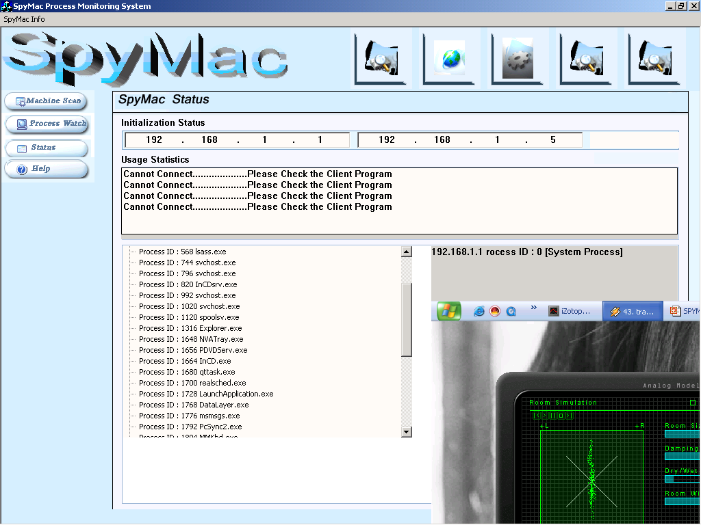

Slide 21
Snapshot - Detailed Description
  The Snapshot command is sent to the client system using Socket Communication
  Client system transfers the file to the server
  The server then displays the file on the right hand side
  On double clicking the image the image is shown on full screen by the default viewer

Slide 22
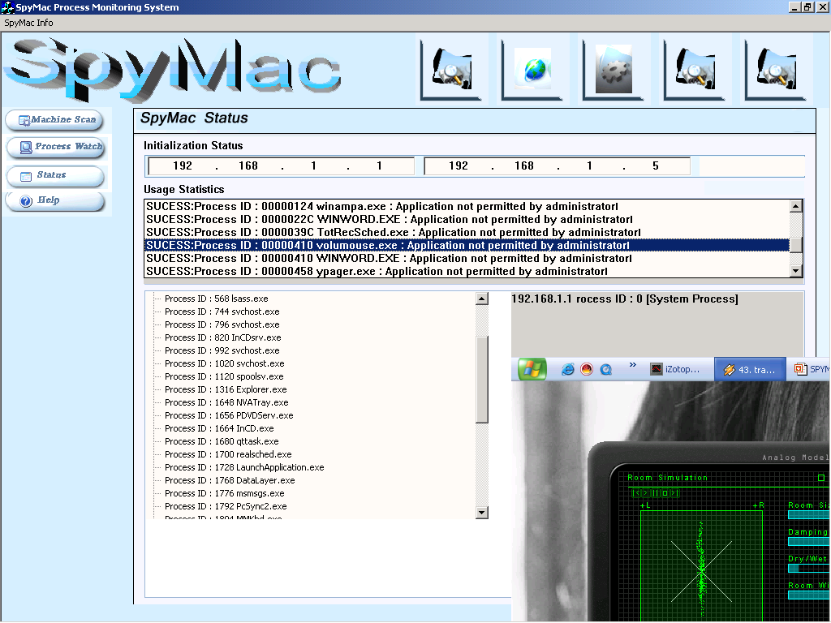

Slide 23
Status Window
  This window displays a list of error messages
  Messages are categorized as follows
    Cannot Connect – Client program is not running
    Unable to Close Process – System process
    Success Process ID – Process terminated successfully

Slide 24
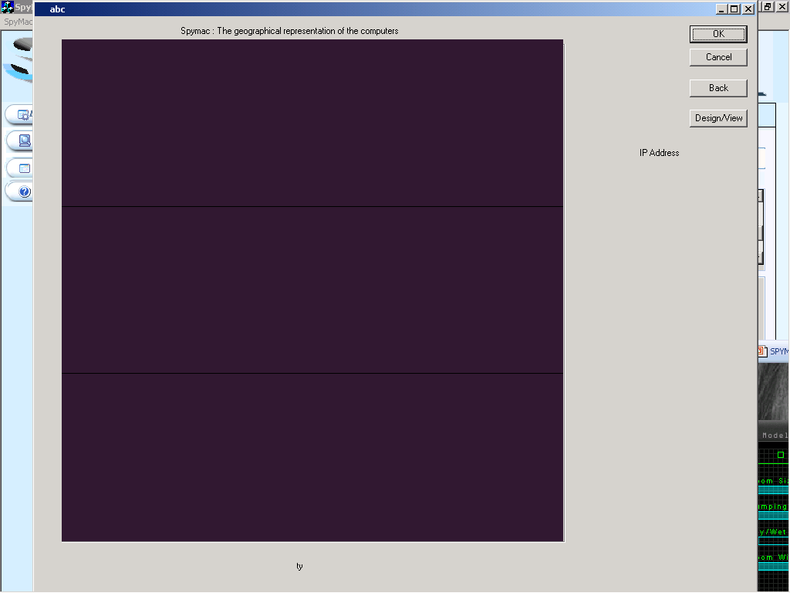

Slide 25
Geographical orientation
The above slide shows the front view of main building where the computers are located
The dialog box shows how many floors the building have
The user is to click on the floor to check the detail of the lab and computer orientation on that floor

Slide 26
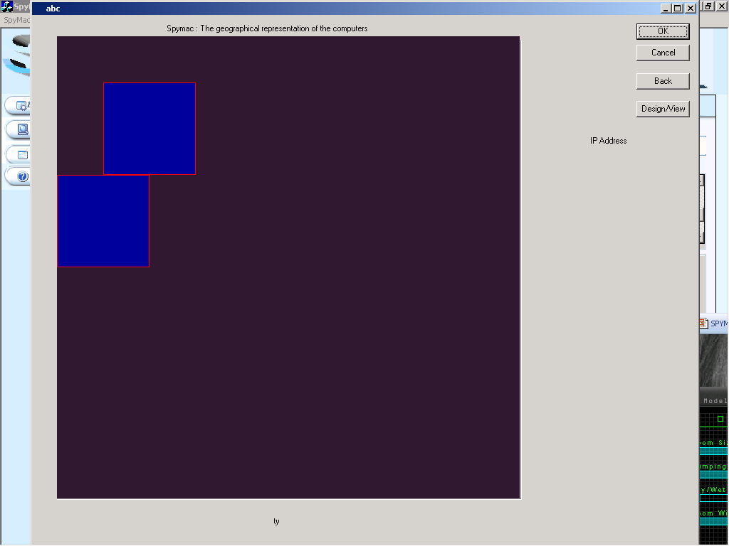

Slide 27
Laboratory view
The top view of a lab is shown
Each blue area shows the lab that is to be accessed
By double clicking on the lab the can see the computer orientation of computers in that lab

Slide 28
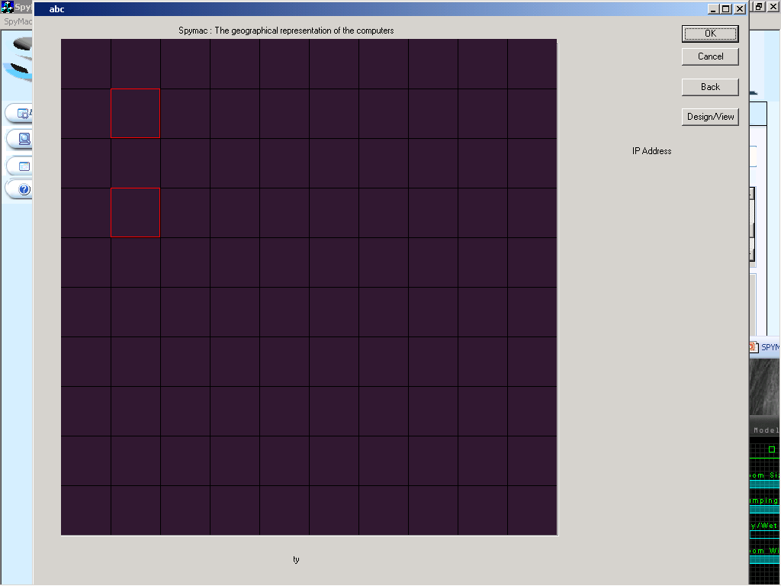

Slide 29
Computer orientation in laboratory
Once the user has selected a particular lab then the user can see all the computers in that lab
Then the user is to click on a particular computer to get the IP address
Once the user gets the IP address user can check for processes from the spymac application

Slide 30


Slide 31
Future Scope
Currently software's are not very easily available for network process monitoring with certain more developments in network security
Some more advantages of this software are that it works on all Windows OS, is very small in size and has a very user friendly and simple interface

Slide 32
A future enhancement of this project will be to check the client system for service packs installed
This software can be easily extended to .NET Platform which has superior process management API’s
Applications
  Organizations
  Universities

